Slide 1
"Improving Preparedness and Response to EU Natural and Man-made Disasters"
European Workshop, Naples, 11 February 2018
Peter Billing
DG ECHO – European Commission

Slide 2
Content
Recent disaster trends
The Union Civil Protection Mechanism (UCPM)?
UCPM Prepardeness and Prevention Activities
rescEU: the way forward

Slide 3
Trends?
A worrying reality

Slide 4
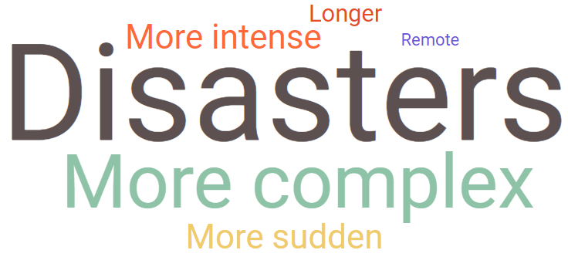



200
Deaths caused by natural disasters in Europe in 2017
€360 bn.
Reported economic losses since 1980 due to weather and climate extreme events in the Union
322%
Increase in the burnt area in 2017 (compared to 2008-16 average), representing 1.8% of total forest mass in Europe
Notes:
Natural disasters across the EU and around the world are significantly increasing in their intensity. Natural disasters are also more complex (e.g. simultaneous, multi-hazard and cross-border), which requires new methods to address them.
In recent years, the Union has faced a large number of disasters with loss of lives and other damaging consequences for citizens, businesses, communities and the environment. In 2017 alone, 200 people were killed by natural disasters in Europe. Due to climate change and a changing risk landscape in Europe, these events are and will increasingly become more extreme and complex.

Slide 5
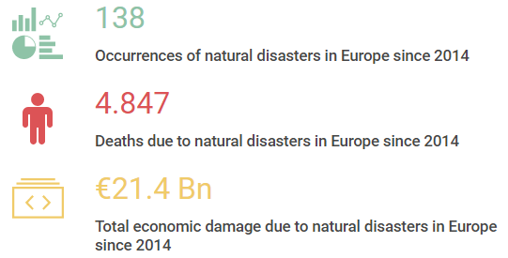
Consequences of natural disasters – EUROPE
(2014-2017)
Source: EM-DAT, consulted 14.12.2017
Notes:
This data comes from the CRED database.

Slide 6
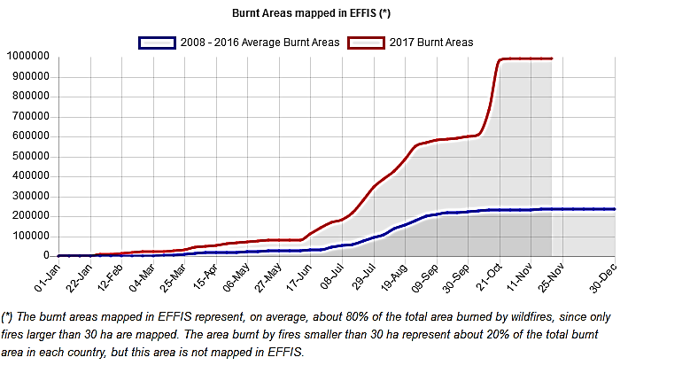
7
10
Notes:
EFFIS data on seasonal trend (FF 2017) - Fires bigger than 30 ha
= 1/3 of Belgium
= x4 Luxembourg
= x10 Berlin
= 1.84% of the entire forest mass (i.e. 53.8 mil. ha) of the six most affected MS by forest fires (PT, ES, IT, FR, HR, GR)

Slide 7
The Union Civil Protection Mechanism (UCPM)

Slide 8
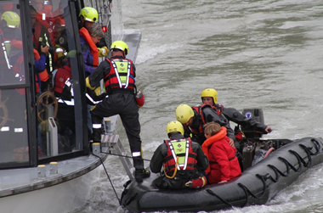
EU Civil Protection Mechanism
Our mandate…
…Encourage cooperation between Member States for preventing protecting, and coordinating response against natural and man-made disasters.
Treaty on the functioning of the European Union – art 196)

Slide 9
Fundamentals of Civil Protection
Responsibility
Solidarity
Voluntary
Request for assistance
European Commission as facilitator
Notes:
Responsibility: Member States are responsible for the security and the safety of their citizens and foreigners on their territory.
Solidarity: Member States have the responsibility to support Member States affected by a disaster when needed. (re-enforced by Lisbon Treaty Solidarity Clause).
Call for assistance: Member States and third countries can call for assistance when overwhelmed by a disaster. After needs identification, they are responsible to receive / and for the use of EU/foreign assistance.
Voluntary: The level of support / assistance is determined by the Member State providing assistance.
Commission as facilitator: EU supports preparation, facilitates cooperation, coordination and complements MS. (Art. 196 Lisbon Treaty).

Slide 10
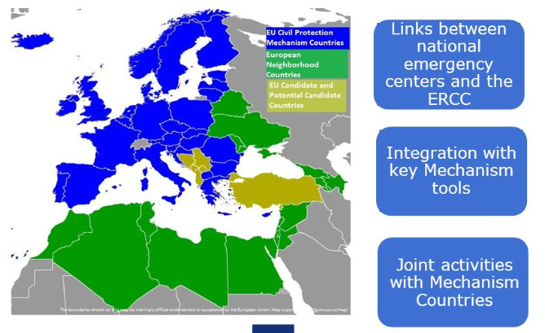
UCPM = Prevention – Preparedness Response – Lessons Learnt
Notes:
Establised in 2001
34 participating countries: 34 participating states: EU 28, Norway, Iceland, FYROM, Montenegro, Serbia and Turkey
Prevention – Preparedness – Response – Lessons Learnt
The Mechanism facilitates cooperation in civil protection assistance interventions in the event of major disasters inside and outside the EU.
The Mechanism's intention is to Enable coordinated assistance from the participating states to victims of natural and manmade disasters

Slide 11
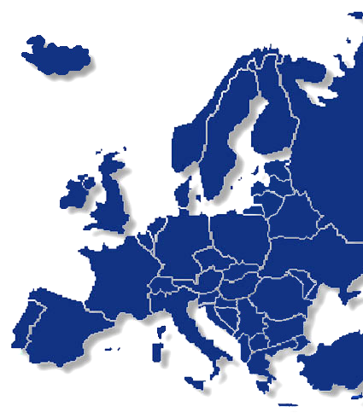
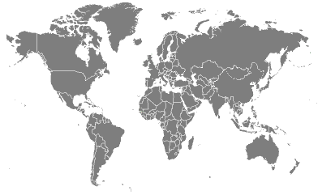

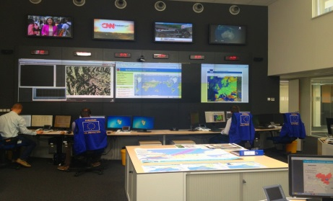



Disaster stricken country
Request for assistance
Acceptance / rejection of offers
Information update
ERCC
Offer of assistance
Deployment of EUCP Teams
Coordination of Transport
Activation of the Mechanism
Notes:
11

Slide 12
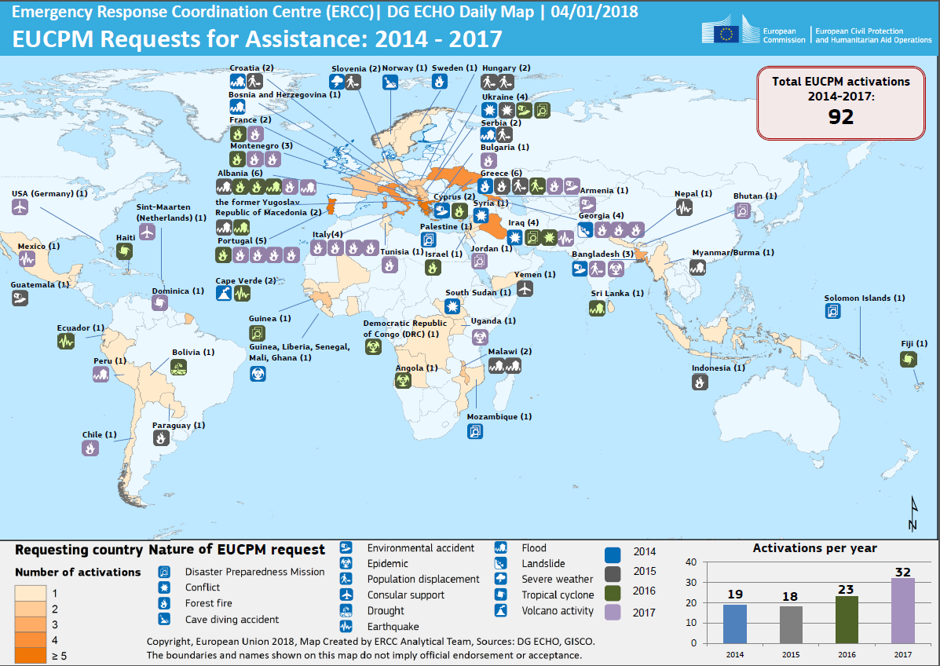

Slide 13
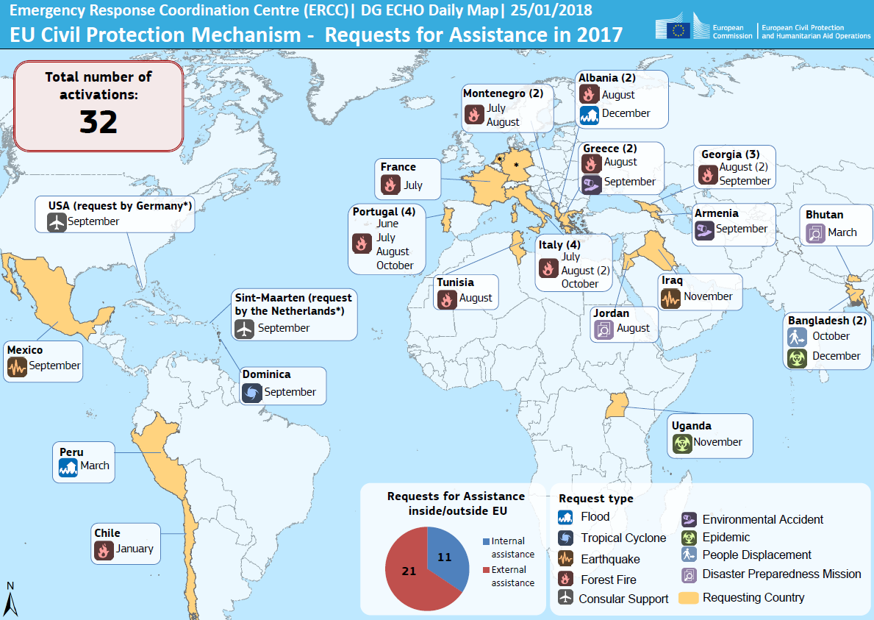

Slide 14
Requests for assistance inside and outside EU

Slide 15
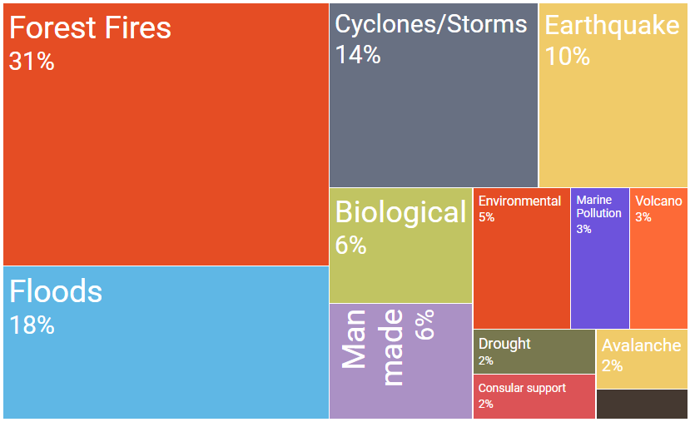











Types of hazard for which the UCPM was activated
(overview 2014-2017, EU & worldwide)
Notes:
This table serves to illustrate the main type of hazard (and their relative weight) for which the UCPM has been activated since 2014.
Main assessed risks of natural disasters in the Union are:
Flooding; (30 PS out of 34)
Extreme weather; (26/34)
Forest Fire; (24/34)
Earthquake (19/34)

Slide 16
Prevention and PreparEdness…

Slide 17
… a state of readiness and capability of human and material means, structures, communities and organisations enabling them to ensure an effective rapid response to a disaster, obtained as a result of action taken in advance.
(Art. 4(3) of Council Decision 1313/2013)

Slide 18

Individual Capacity
Preparedness –
a building block approach
National Training
Int. Training for national Experts
Training Courses
Exchange of Experts
Team Capacity
National Team Training
Int. Training for national Teams
Table Top Exercises
Modules Exercises
Structural Capabilities
National Exercises
Regional Exercises
International Exercises
UCPM Exercises
EDREX

Slide 19
Prevention and Preparedness in the UCPM
P+P projects
Early warning systems
Voluntary Pool (interoperability, availability)
Exchange of experts programme
Training courses and Training network
Exercises

Slide 20
Prevention and Preparedness Projects
Objectives:
  improve prevention and preparedness
  Enhance knowledge about disasters
  Innovative technologies
  Awareness raising
  Develop cooperation across Europe
Call for projects open (DDL: 25 April)
Application to be submitted by min. 3 entities
Support from nationa CP authorities
4.2 m€ budget
Max 800.000€ per project
75% co-financing rate
http://ec.europa.eu/research/participants/portal/desktop/en/opportunities/ucpm/topics/ucpm-2018-pp-prep-ag.html

Slide 21
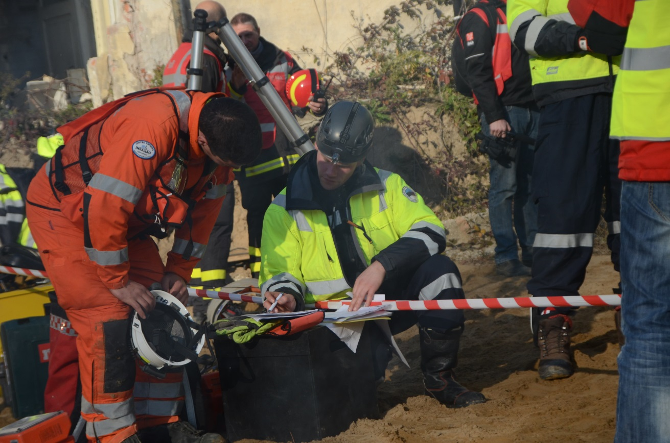
Strengthening TRAINING

Slide 22
Training Programme
(2012 – 2016)
14th – 17th course cycle
Status: September 2015
Online preparation
MODULES
All
TECHNICAL EXPERTS
INTRODUCTION
MBC
CMI
TEC/ TEC MI
OPERATIONAL
EU CPT members
ModTTEx
SMC
AMC
SME
OPM
ModEx
SEC
CND
MANAGEMENT
HLC

Slide 23
Since 2004
521 courses will have been conducted
11.000 course places will have been allocated
Over 7000 experts will have been trained

Slide 24
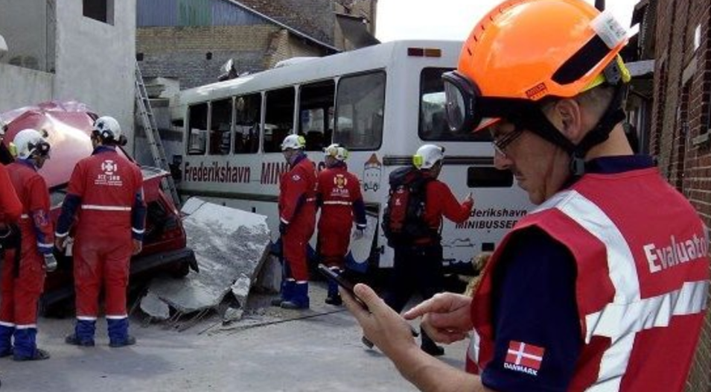
Exercises: Modules exercises
MODEX = to better prepare the participants for International deployments
9 field & 5 table top exercises
2300 Participants last 2 years from 30 countries

Slide 25
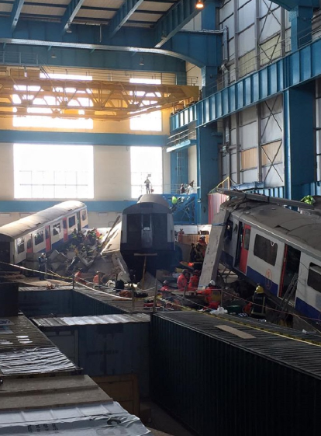
UCPM Exercises
4-5 large-scale international exercises per year
To test capacities & capabilities during overwhelming disasters

Slide 26
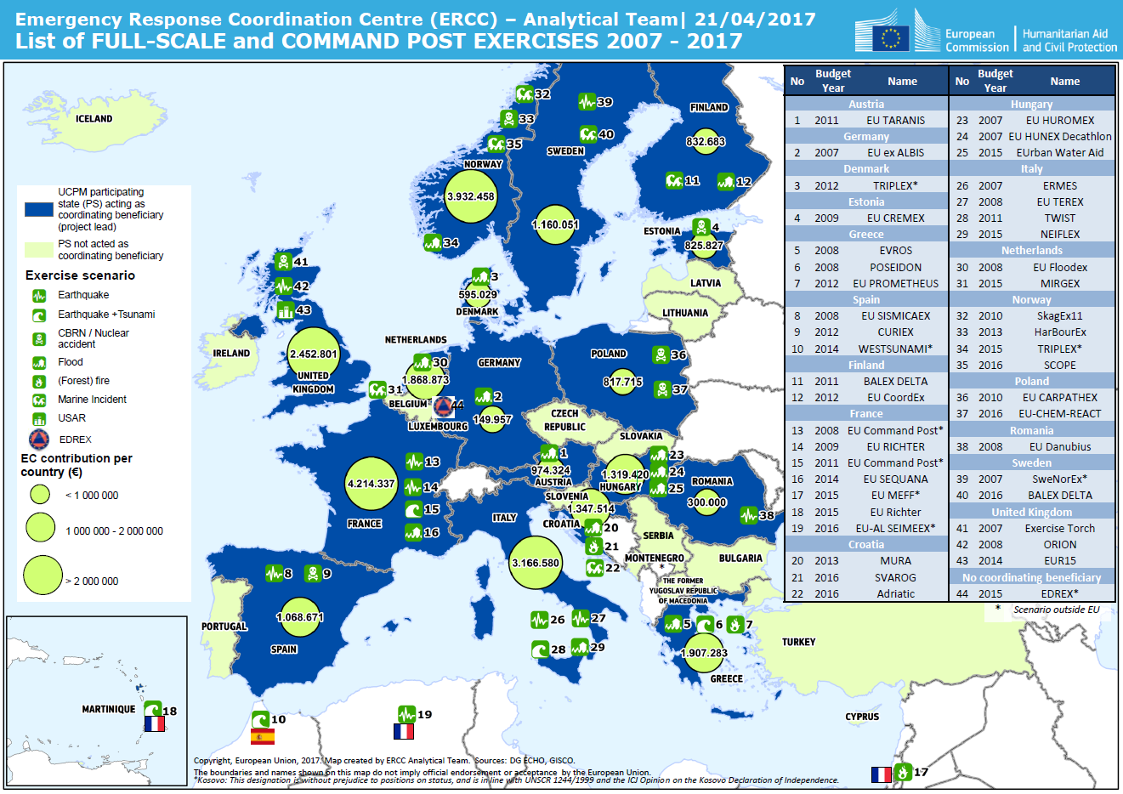

Slide 27
rescEU: solidarity and responsibility

Slide 28
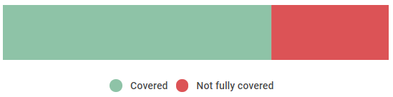
Requests for Assistance (2014-2017)
64 covered
20 partially covered
8
Not covered
30%
Not fully met
Notes:
Out of the 96 activations, 31 were not fully met:
8 not met at all
23 partially met
Representing a total of 30% of activations not fully met.

Slide 29
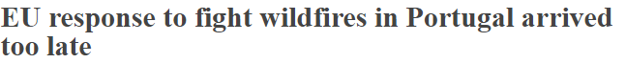
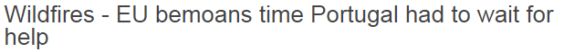
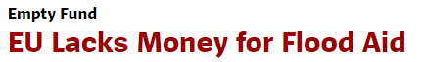
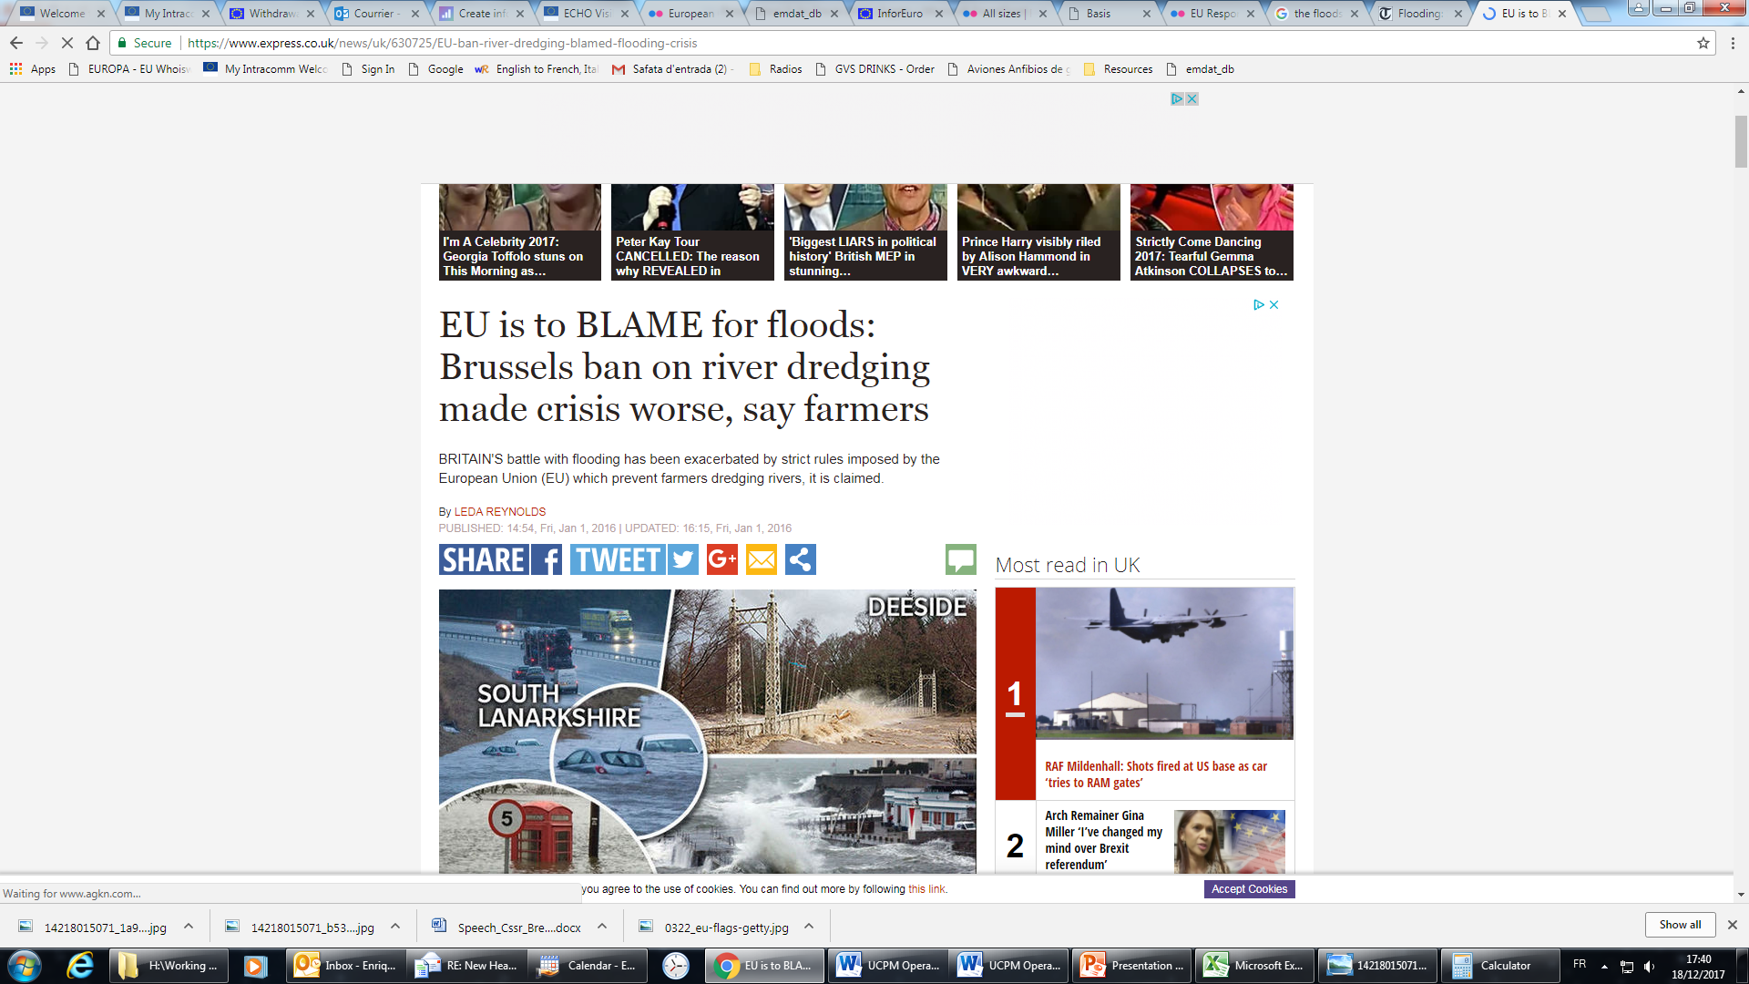
…media coverage
The Brussels Times, 17.10.2017
The Portugal News, 24.10.2017
Der Spiegel, 6.06.2017
Express, 1.01.2016
Notes:
The positive public perception about European CP policy is not fully reflected in its media coverage or EP Questions.

Slide 30

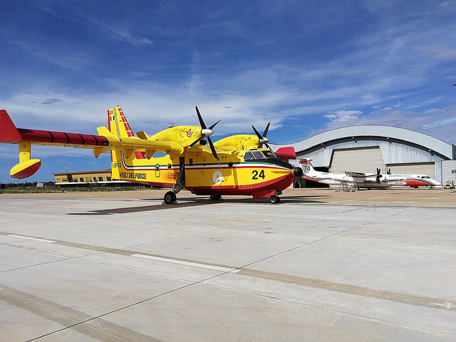
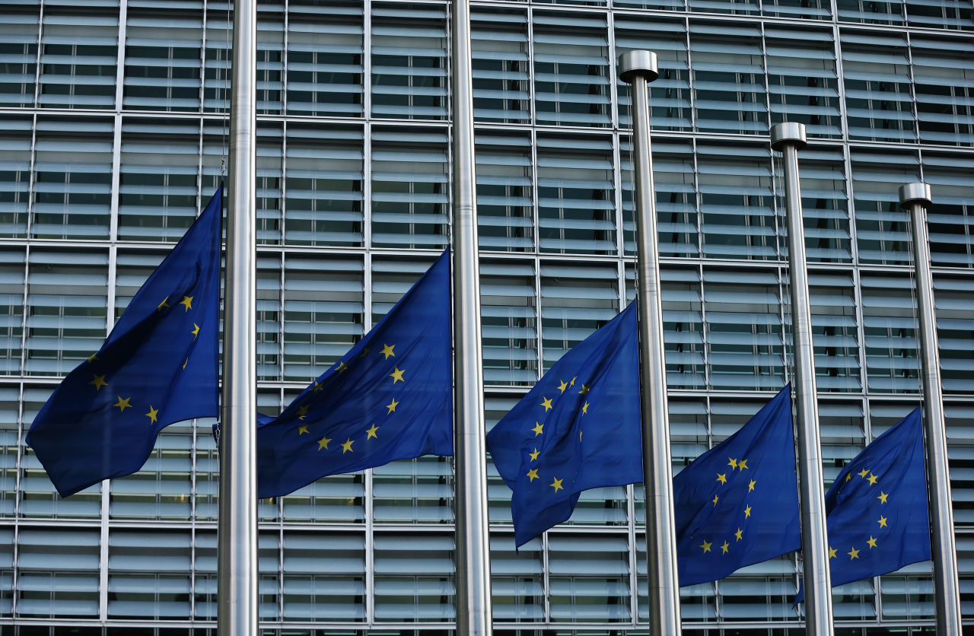
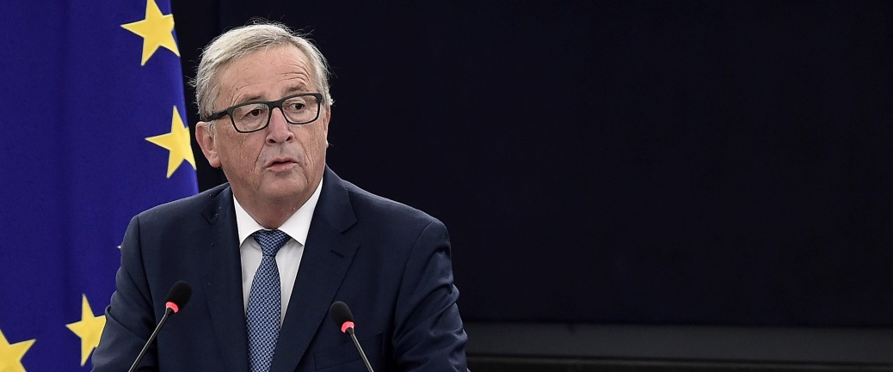
(©UNICEF/Gevgelijia 2015/Georgiev)
©EU/ECHO/Jean-Jacques Bozabalian
"Member States must build a Europe that protects. And we, the European institutions, must help them deliver this promise"
Strasbourg, 14.09.2016
Notes:
This is a political initiative, initiated by the President of the Commission and with the full support of the College.
It contributes to deliver on a 'Europe that protects'.

Slide 31
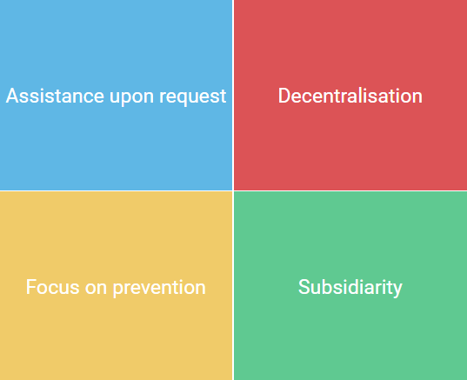
Keeping the principles of the Mechanism
Improve the system based on these principles
Notes:
The working assumption of this proposal is that we keep the same basic principle of the Mechanism, and that we improve the system based on those principles.
Assistance upon request. As currently, the Mechanism will only be activated if there is a request from a MS. No 'right of initiative' for the Commission.
Decentralisation: in particular of assets and operational decision-making on the ground
Focus on prevention: this aspect is significantly reinforced in this proposal (see further)
Non-intrusion: subsidiarity is respected. Primarily, this is a MS competence. Commission only supportive role.

Slide 32

This proposal in a nutshell
1
Reinforced prevention
New
Mechanism
2
Increased predictability of response
3
Administrative simplification
Notes:
In the area of preparedness/response, the main innovation is the evolution from a single system of voluntary contributions coming from Member States, to a dual system of voluntary contributions from MS and own EU capacities.
The Voluntary Pool is rebranded as European Civil Protection Pool and the new operational capacity is known as rescEU.
For rescEU, the Commission will be able to purchase/lease a set of assets (defined in the legislation: aerial means, HUSAR, HCP, EMT) at 100% and will be in charge of managing these assets.
For prevention, see slides below.
For administrative simplificaiton, co-financing rates for the new ECPP are set at 75%, including also operating costs (inside the EU). This constitutes a major innovation in relation to the current framework.
Another innovation is the reinforcement of the training network into a 'Union Civil Protection Knowledge Network'. The change is not major, but it implies a stronger coordination role for the Commission in liason with the natioinal authorities to provide specific UCPM training. This is relevant, especially with the establishment of rescEU.

Slide 33


Reinforced prevention
Recovery
Risk assessment
Response
Preparedness
Prevention
Notes:
A key pillar of the proposal is strengthened prevention. Because only through reducing the risks of disasters can we minimise their impacts and deal with them effectively.
Currently, we only receive risk assessments from Member States which they have to submit as part of the legislation. However, the loop needs to be closed and these need to be linked with the rest of the cycle. We also do not know what MS are doing in response to the risks identified. The Commission wants to support MS in prevention (also through EU funds) but first needs to know what is already happening at MS level.

Slide 34
Increased predictability in response
Subsidiarity firmly embedded
National
Capacities
First responders
Reserve of civil protection capacities:
Aerial Firefighting means
High Capacity Pumping
Urban Search and Rescue
Field hospital and emergency medical teams
NB: Delegated act to revise composition of rescEU
European Civil Protection Pool
rescEU
Mutual assistance
Safety net
Notes:
This slide should serve to illustrate the 'hierarchy' of responsibility to respond to disasters. This proposal has subsidiarity firmly embedded.
National capacities continue to be the first responders. Only if these are overwhelmed, then the ECPP can offer mutual assistance. And only if this is not enough, the new reserve rescEU can enter into play.
rescEU is a reserve at European level of civil protection capabilities such as aerial forest fighting planes, special water pumps, urban search and rescue and field hospitals and emergency medical teams.
Moreover, as outlined in the Communication, there is the potential to maximise the use of European Structural and Investment Funds to strenghten the European Civil Protection Pool

Slide 35
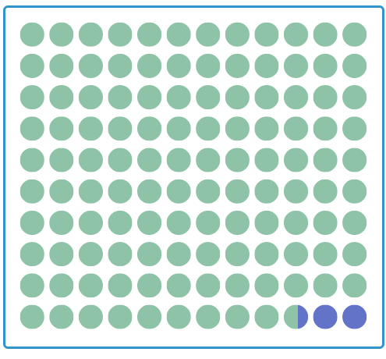

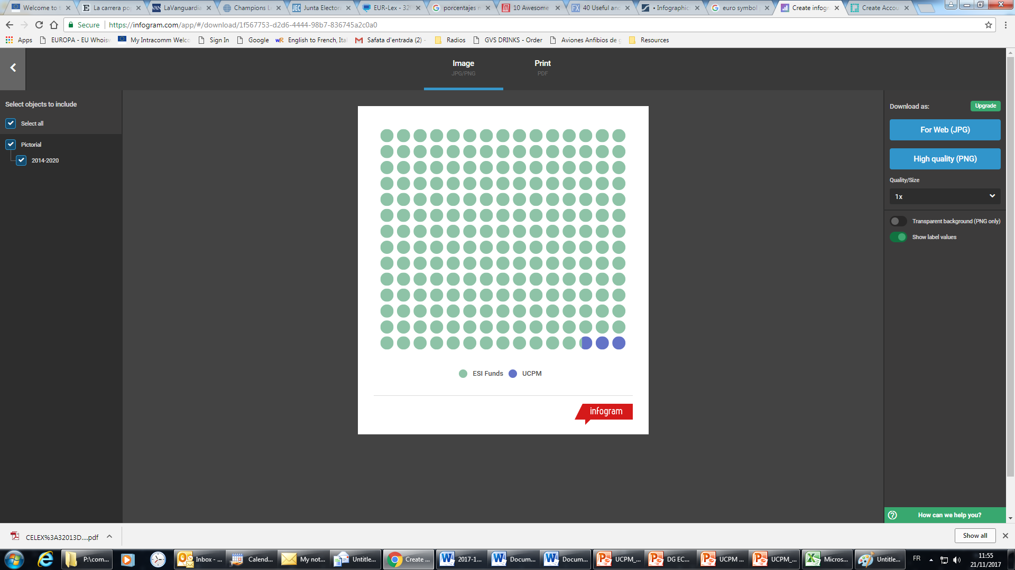
Strengthening complementarity with other EU policies
Comparison of European Structural and Investment funds (€ 11.7 Bn.) and UCPM funds (€ 241 mil.) related to prevention and preparedness during 2014-2020
€8 Bn. | Climate change adaptation and disaster prevention (Cohesion Policy)
€2.3 Bn. | Forestry measures (European Agricultural Fund for Rural Development)
€1.4 Bn. | Recovery (EU Solidarity Fund)
Ratio 1:48.5
= 100 mil. ESI Funds
= 100 mil. UCPM
Notes:
This slide clearly illustrates the argument about the insufficient linkage between the UCPM and other instruments in relation to prevention activities.
Most of EU funds supporting disaster prevention and management activities are currently earmarked through the European Structural and Investment Funds:
Over the period of 2014-2020, almost EUR 8 billion have been allocated by 20 Member States for climate change adaptation and disaster prevention and management through Cohesion Policy funds, making them the largest source of EU funding in this area
The European Agricultural Fund for Rural Development (EAFRD) includes a focus area on supporting farm risk prevention and management under its priority for rural development. This fund also supports forestry measures which include specific forest fire prevention and restoration measures. Some EUR 2,3 billion have been specifically earmarked over the period of 2014-2020 for this purpose. A vast majority of the planned measures to support investment in prevention action to reduce the consequences of natural disasters and catastrophic events as well as for the restoration of agricultural land and production potential are yet to be executed in the current programming period.
Moreover, since 2014 (and up to 2016), the EU Solidarity Fund, as a (re-)financing instrument for emergency and recovery operations following severe natural disasters, the Commission awarded a total amount of over EUR 1.4 billion in EU financial assistance for post-disaster interventions. Of the € 1.4 billion only € 11.2 million were allocated to forest fire events (in PT and CY). This represent roughly 0.8% of the overall aid.
En revanche, UCPM funds for prevention&preparedness for the whole MFF period were 206mil (inside) and 35mil (outside)

Slide 36
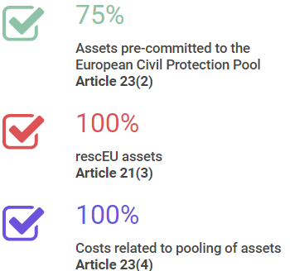
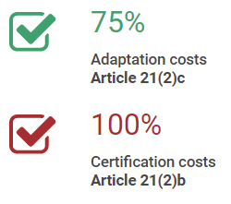
Administrative simplification
A less complex SET OF RULES
Notes:
This slide serves to summarise the main elements than around the theme simplification.
Rates
De-activation
Articulation with HAR (to cover costs for operaitons outside the EU), by derogation of some provisions of Financial Regulation

Slide 37
Knowledge Network
Development of a dedicated European Civil Protection Knowledge Network,
Aims:
reinforce the training component of the Union's Civil Protection Mechanism, based around close cooperation with the relevant national structures on the matter.
strengthen the efficiency of common EU disaster management.
Ppan-European network of specialised training and exercise centers, in which European and international best practice would be disseminated, inter-operability and host nation support measures reinforced and joint EU exercises undertaken.
European Civil Protection Knowledge Network will help foster co-operation and mutual understanding, and help to build a common Union disaster preparedness culture.
Through increased co-operation, joint training and scenario-based exercises the efficiency of common EU disaster preparedness and response will be increased.

Slide 38
EUCPM Knowledge Network
Modules
EUCPT
course
1
course
2
Certification
Certification
Specialised expertise courses
Exercises
Training
Exchange of Experts /Erasmus
EUCPM Exercises
Disaster Management Master
Exercises
course
3
course
X
Host Nation Support (HNS)
Advanced training
Training
EUCPM entry level training

Slide 39
In conclusion…
rescEU
Reinforces the EU's and Member States’ collective ability to respond to disasters, and address recurrent and emerging capacity gaps, by putting in place a dual system of response capacity: a dedicated reserve of response capacities with command at control at Union level, to be known as rescEU; and a more effective and dynamic contribution from Member States through a European Civil Protection Pool.
Strengthens the focus on prevention action as part of the disaster risk management cycle, as well as reinforce coherence with other key EU policies acting, inter alia, in the field of climate change adaptation, disaster prevention and disaster response;
Ensures the Union's Civil Protection Mechanism is agile and effective in its administrative procedures in support of emergency operations.

Slide 40
Thank you.

