Slide 1

Non-structural measures for the mitigation of natural risks
‘’COME MIGLIORARE LA GESTIONE DEI DISASTRI AMBIENTALI E NON: opportunità per una rete comune di agenzie di formazione dell’UE’’
Workshop Europeo – Napoli, 10 Febbraio 2018
Università degli Studi di Napoli "Federico II"
Dipartimento di Scienze della Terra, dell’Ambiente e delle Risorse
Prof. Domenico Calcaterra

Slide 2
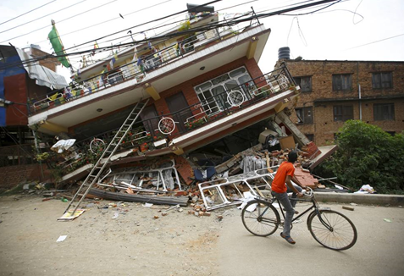
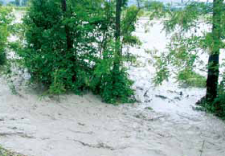
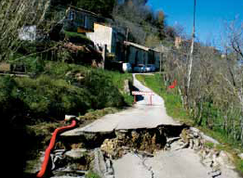
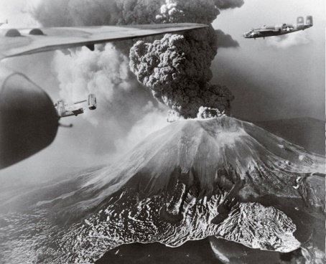
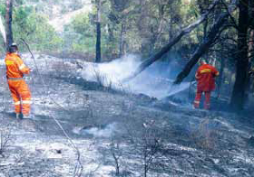
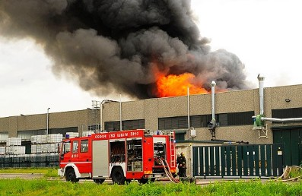
‘’COME MIGLIORARE LA GESTIONE DEI DISASTRI AMBIENTALI E NON: opportunità per una rete comune di agenzie di formazione dell’UE’’
Workshop Europeo – Napoli, 10 Febbraio 2018
Natural risks in Italy
Italy has a high exposure to natural risks: earthquakes, floods, landslides, volcanic eruptions, fires. Natural hazards which add up to those related to human activities, which contribute to making our fragile territory. Risk prediction and prevention, relief to the affected populations, contrast and overcoming the emergency and risk mitigation are the civil protection activities identified by the Law no. 225/92, which established the National Service. Protection of people and safeguard of the territory are the main objectives of these activities. Prediction activities- carried out with the participation of relevant scientific and technical subjects - aim to assess risk scenarios and, when possible, to give notice, monitor and supervise events and risk levels expected.

Slide 3
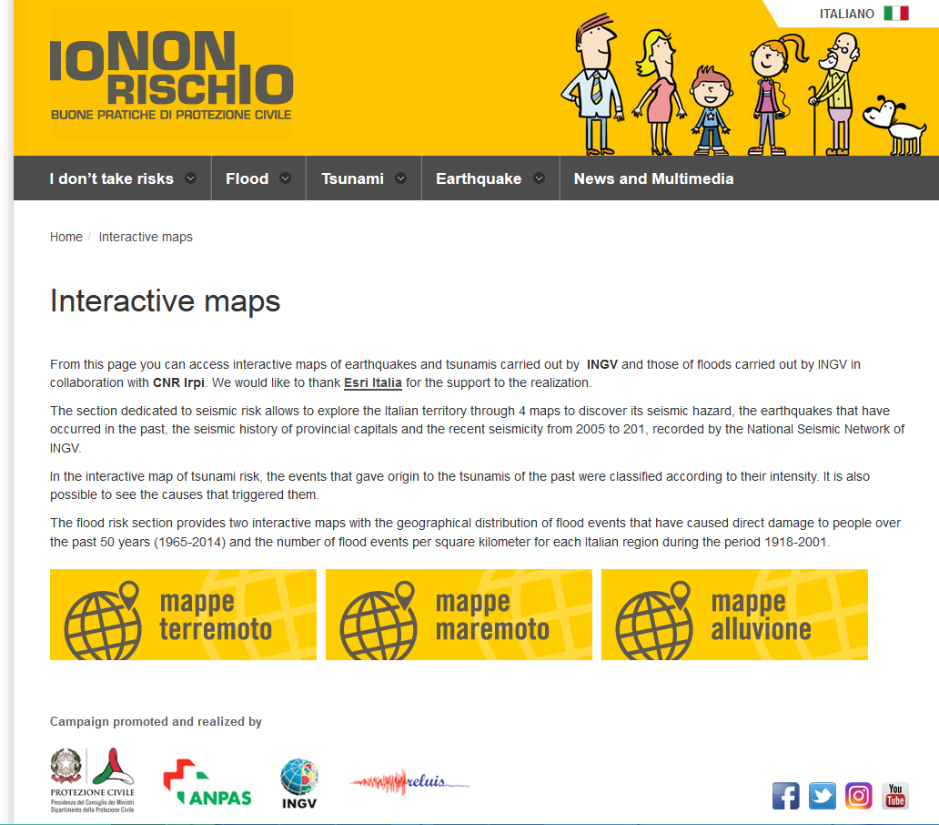

‘’COME MIGLIORARE LA GESTIONE DEI DISASTRI AMBIENTALI E NON: opportunità per una rete comune di agenzie di formazione dell’UE’’
Workshop Europeo – Napoli, 10 Febbraio 2018
Communication campaign
Early warning, planning, training, dissemination of knowledge, information to the population, drills, and application of technical regulations are the main instruments for the prevention of territorial risks and are intended to prevent or limit damage in the event of an emergency.
It is a national communication campaign on best practices of civil protection. It highlights that the individual exposition to such risks can be considerably reduced through the knowledge of the problem, the awareness of the possible consequences and the adoption of a few simple expedients.
(http://iononrischio.protezionecivile.it/)
The EDURISK project aims to educational tools and activities dealing with the topic of seismic and volcanic risk for Italian schools.
(www.edurisk.it)

Slide 4
How an Emergency Plan (EP) is made
‘’COME MIGLIORARE LA GESTIONE DEI DISASTRI AMBIENTALI E NON: opportunità per una rete comune di agenzie di formazione dell’UE’’
Workshop Europeo – Napoli, 10 Febbraio 2018
The emergency plan is an essential tool for the prevention of risks. Disaster management is the series of intervention operative procedures to cope with any expected calamity in a particular territory.
General part Lines of planning Intervention model
It includes all the information on the features and on the structure of the territory.
They establish the objectives to achieve in order to provide a suitable civil protection response to any emergency situation, and the skills of the various operators.
Assigns the decision making responsibilities to the various levels of command and control, uses the resources in a rational manner, defines a communication system which allows a constant exchange of information.
- What is a natural disaster?
- How do we know which areas are at risk?
- Can natural disaster be expected?
- What can be done to reduce the risk of natural disaster?
- What do you need to know?
- What do you need to do?
Information and Training

Slide 5
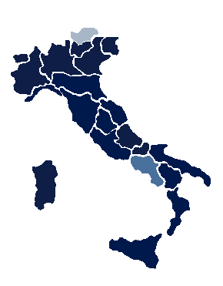

‘’COME MIGLIORARE LA GESTIONE DEI DISASTRI AMBIENTALI E NON: opportunità per una rete comune di agenzie di formazione dell’UE’’
Workshop Europeo – Napoli, 10 Febbraio 2018
Regions/ Autonomous Provinces with EP

Slide 6


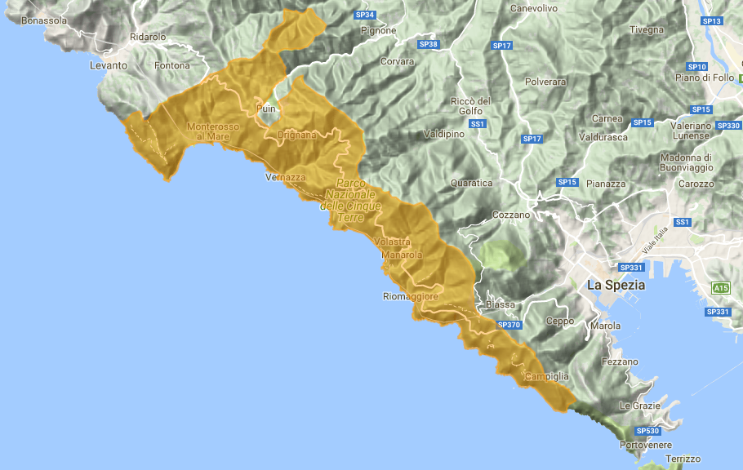
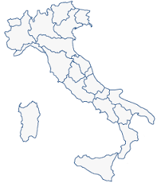
‘’COME MIGLIORARE LA GESTIONE DEI DISASTRI AMBIENTALI E NON: opportunità per una rete comune di agenzie di formazione dell’UE’’
Workshop Europeo – Napoli, 10 Febbraio 2018
Parco Nazionale delle Cinque Terre
UNESCO world heritage site
Protected Area (about 4000 ha) 5 Municipalities
7 Railway stations 53 Itineraries

Slide 7
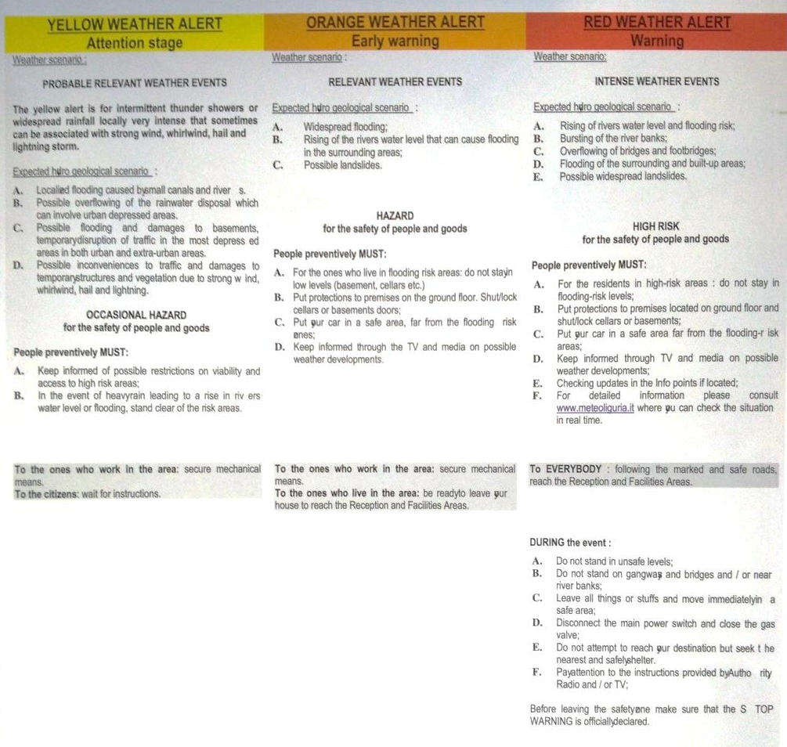
‘’COME MIGLIORARE LA GESTIONE DEI DISASTRI AMBIENTALI E NON: opportunità per una rete comune di agenzie di formazione dell’UE’’
Workshop Europeo – Napoli, 10 Febbraio 2018
Self Protection Rules
Probable relevant weather events
Relevant weather events
Intense weather events

Slide 8
‘’COME MIGLIORARE LA GESTIONE DEI DISASTRI AMBIENTALI E NON: opportunità per una rete comune di agenzie di formazione dell’UE’’
Workshop Europeo – Napoli, 10 Febbraio 2018
Tourists’ interview
Do you know that the Park is affected by flooding risk?
Do you know that the Park is provided with an Emergency Plan?
Sources
Do you know what do you need to do during alert?
Do you believe that the information received were clear and detailed?

Slide 9
‘’COME MIGLIORARE LA GESTIONE DEI DISASTRI AMBIENTALI E NON: opportunità per una rete comune di agenzie di formazione dell’UE’’
Workshop Europeo – Napoli, 10 Febbraio 2018
Sellers’ interview
Asset type
Do you know that the Park is provided with an Emergency Plan?
Do you know the protection rules?
Sources

Slide 10
‘’COME MIGLIORARE LA GESTIONE DEI DISASTRI AMBIENTALI E NON: opportunità per una rete comune di agenzie di formazione dell’UE’’
Workshop Europeo – Napoli, 10 Febbraio 2018
Sellers’ interview
Do you believe that it is important to inform the tourists on protection rules?
Which do you believe it is the best way to inform them?

Slide 11
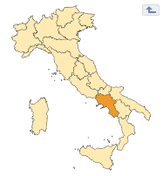
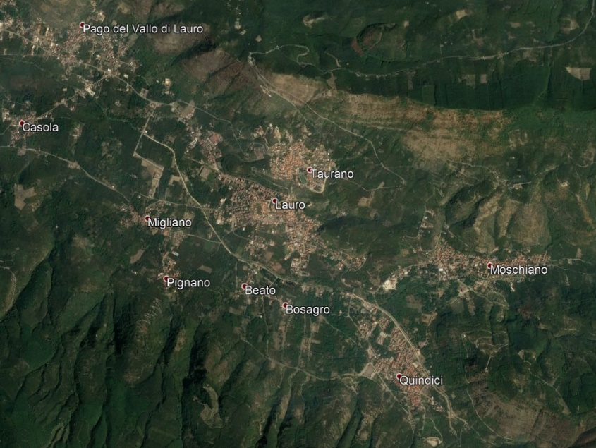
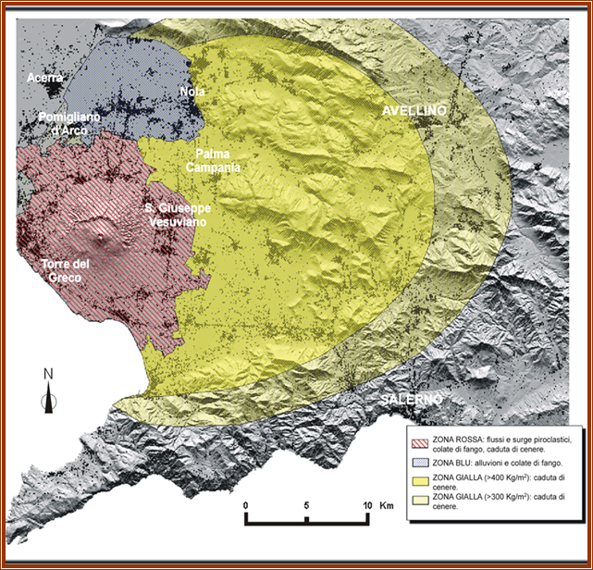
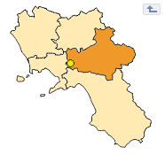
‘’COME MIGLIORARE LA GESTIONE DEI DISASTRI AMBIENTALI E NON: opportunità per una rete comune di agenzie di formazione dell’UE’’
Workshop Europeo – Napoli, 10 Febbraio 2018
Lauro (AV) Municipality
Lauro
Risks:
- Hydro-geomorphological (landslide, flood) - Volcanic
- Earthquake
- Fire - Snow

Slide 12
‘’COME MIGLIORARE LA GESTIONE DEI DISASTRI AMBIENTALI E NON: opportunità per una rete comune di agenzie di formazione dell’UE’’
Workshop Europeo – Napoli, 10 Febbraio 2018
Perception of Risks
Risks
 | %
Landslide | 60
Earthquake | 45
Flood | 28
Fire | 19
Industrial | 17
Volcanic | 10
Snow | 3
Knowledge of event
 | %
Landslide | 60
Earthquake | 48
Flood | 27
Volcanic | 45
Likelihood of occurrence
 | %
Landslide | 58
Earthquake | 53
Fire | 32
Snow | 5
Landslide = detachment
Flood = sediment
Earthquake = surface displacement
Volcanic = magma flow
Safety during earthquake
 | %
Yes | 30
No | 5
I don't know | 30
Safety during eruption
 | %
Yes | 25
No | 17
I don't know | 23

Slide 13
‘’COME MIGLIORARE LA GESTIONE DEI DISASTRI AMBIENTALI E NON: opportunità per una rete comune di agenzie di formazione dell’UE’’
Workshop Europeo – Napoli, 10 Febbraio 2018
Knowledge of Plans
- Only the 6% of the interviewed knows that Lauro Municipality lies into Yellow zone for Vesuvio risk plan; about the 30% don’t know;
Lauro
- Only the 55% of the interviewed knows that the Municipality shall have an EP (updated in the 2015);
- Only the 5% of the interviewed has partecipated to emergency evacuation procedure;
- Only the 18% of the interviewed are satisfied by the information received from EP, while the 29% are not satisfied.

Slide 14
‘’COME MIGLIORARE LA GESTIONE DEI DISASTRI AMBIENTALI E NON: opportunità per una rete comune di agenzie di formazione dell’UE’’
Workshop Europeo – Napoli, 10 Febbraio 2018
How to improve risk perception
The EP will be efficient if the population reaches the risk perception of what they have to live with and that is possible appling the following concept:
Risk awareness
Self-motivation
Autoprotection
Knowing if the area where you live, work or stay is exposed to natural disasters helps to prevent and better deal with emergency situations.
Identify the tools that the Municipality and the Region use to send out the alert and stay constantly informed
Resilience

